Slide 1
Multi-Axial Angular Sensor Design
L3Harris Technologies
Team 310 12/07/2023

Slide 2
Table of Contents
Team Introductions
Project Description
Functional Decomposition
Targets
Concept Generation and Selection
Bill of Materials

Slide 3
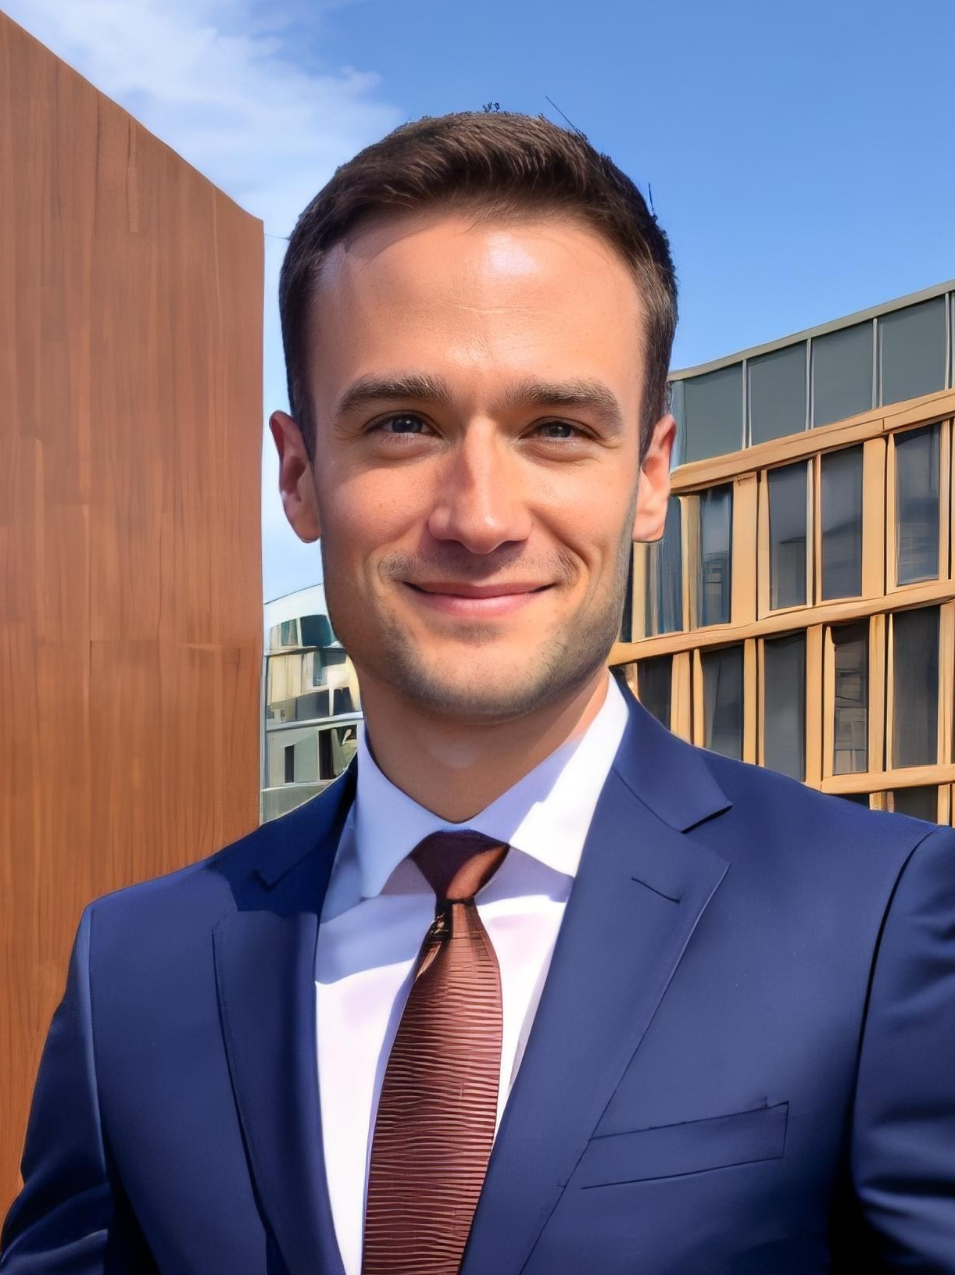
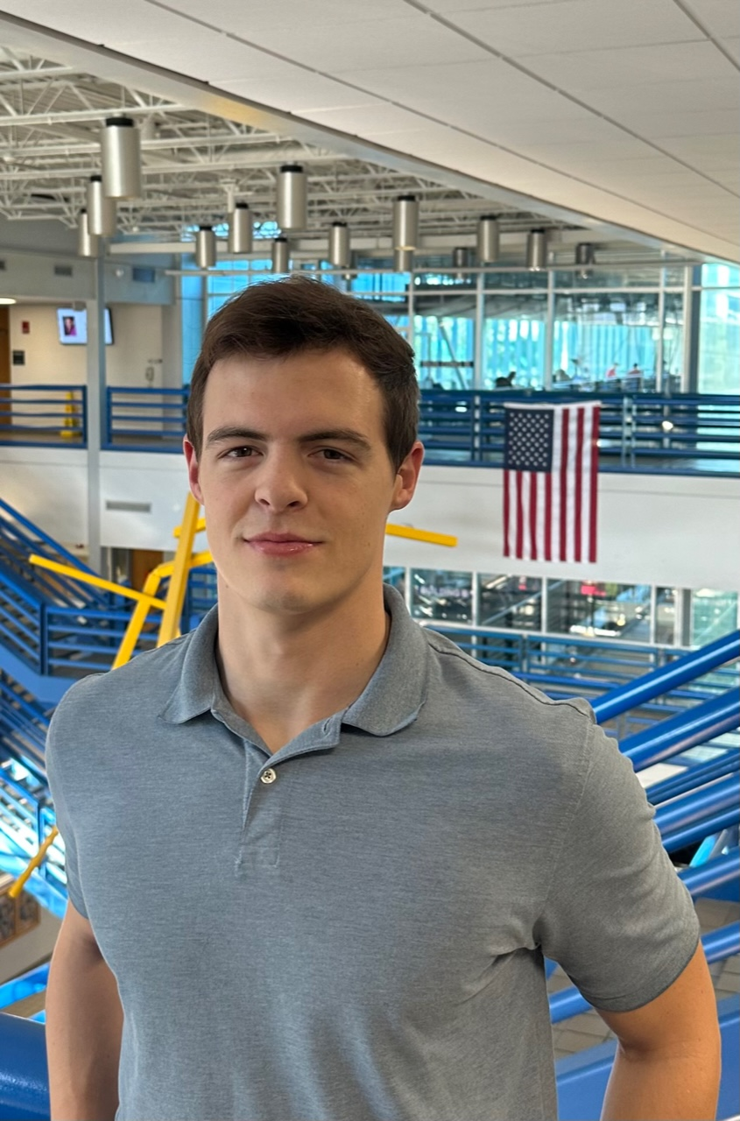
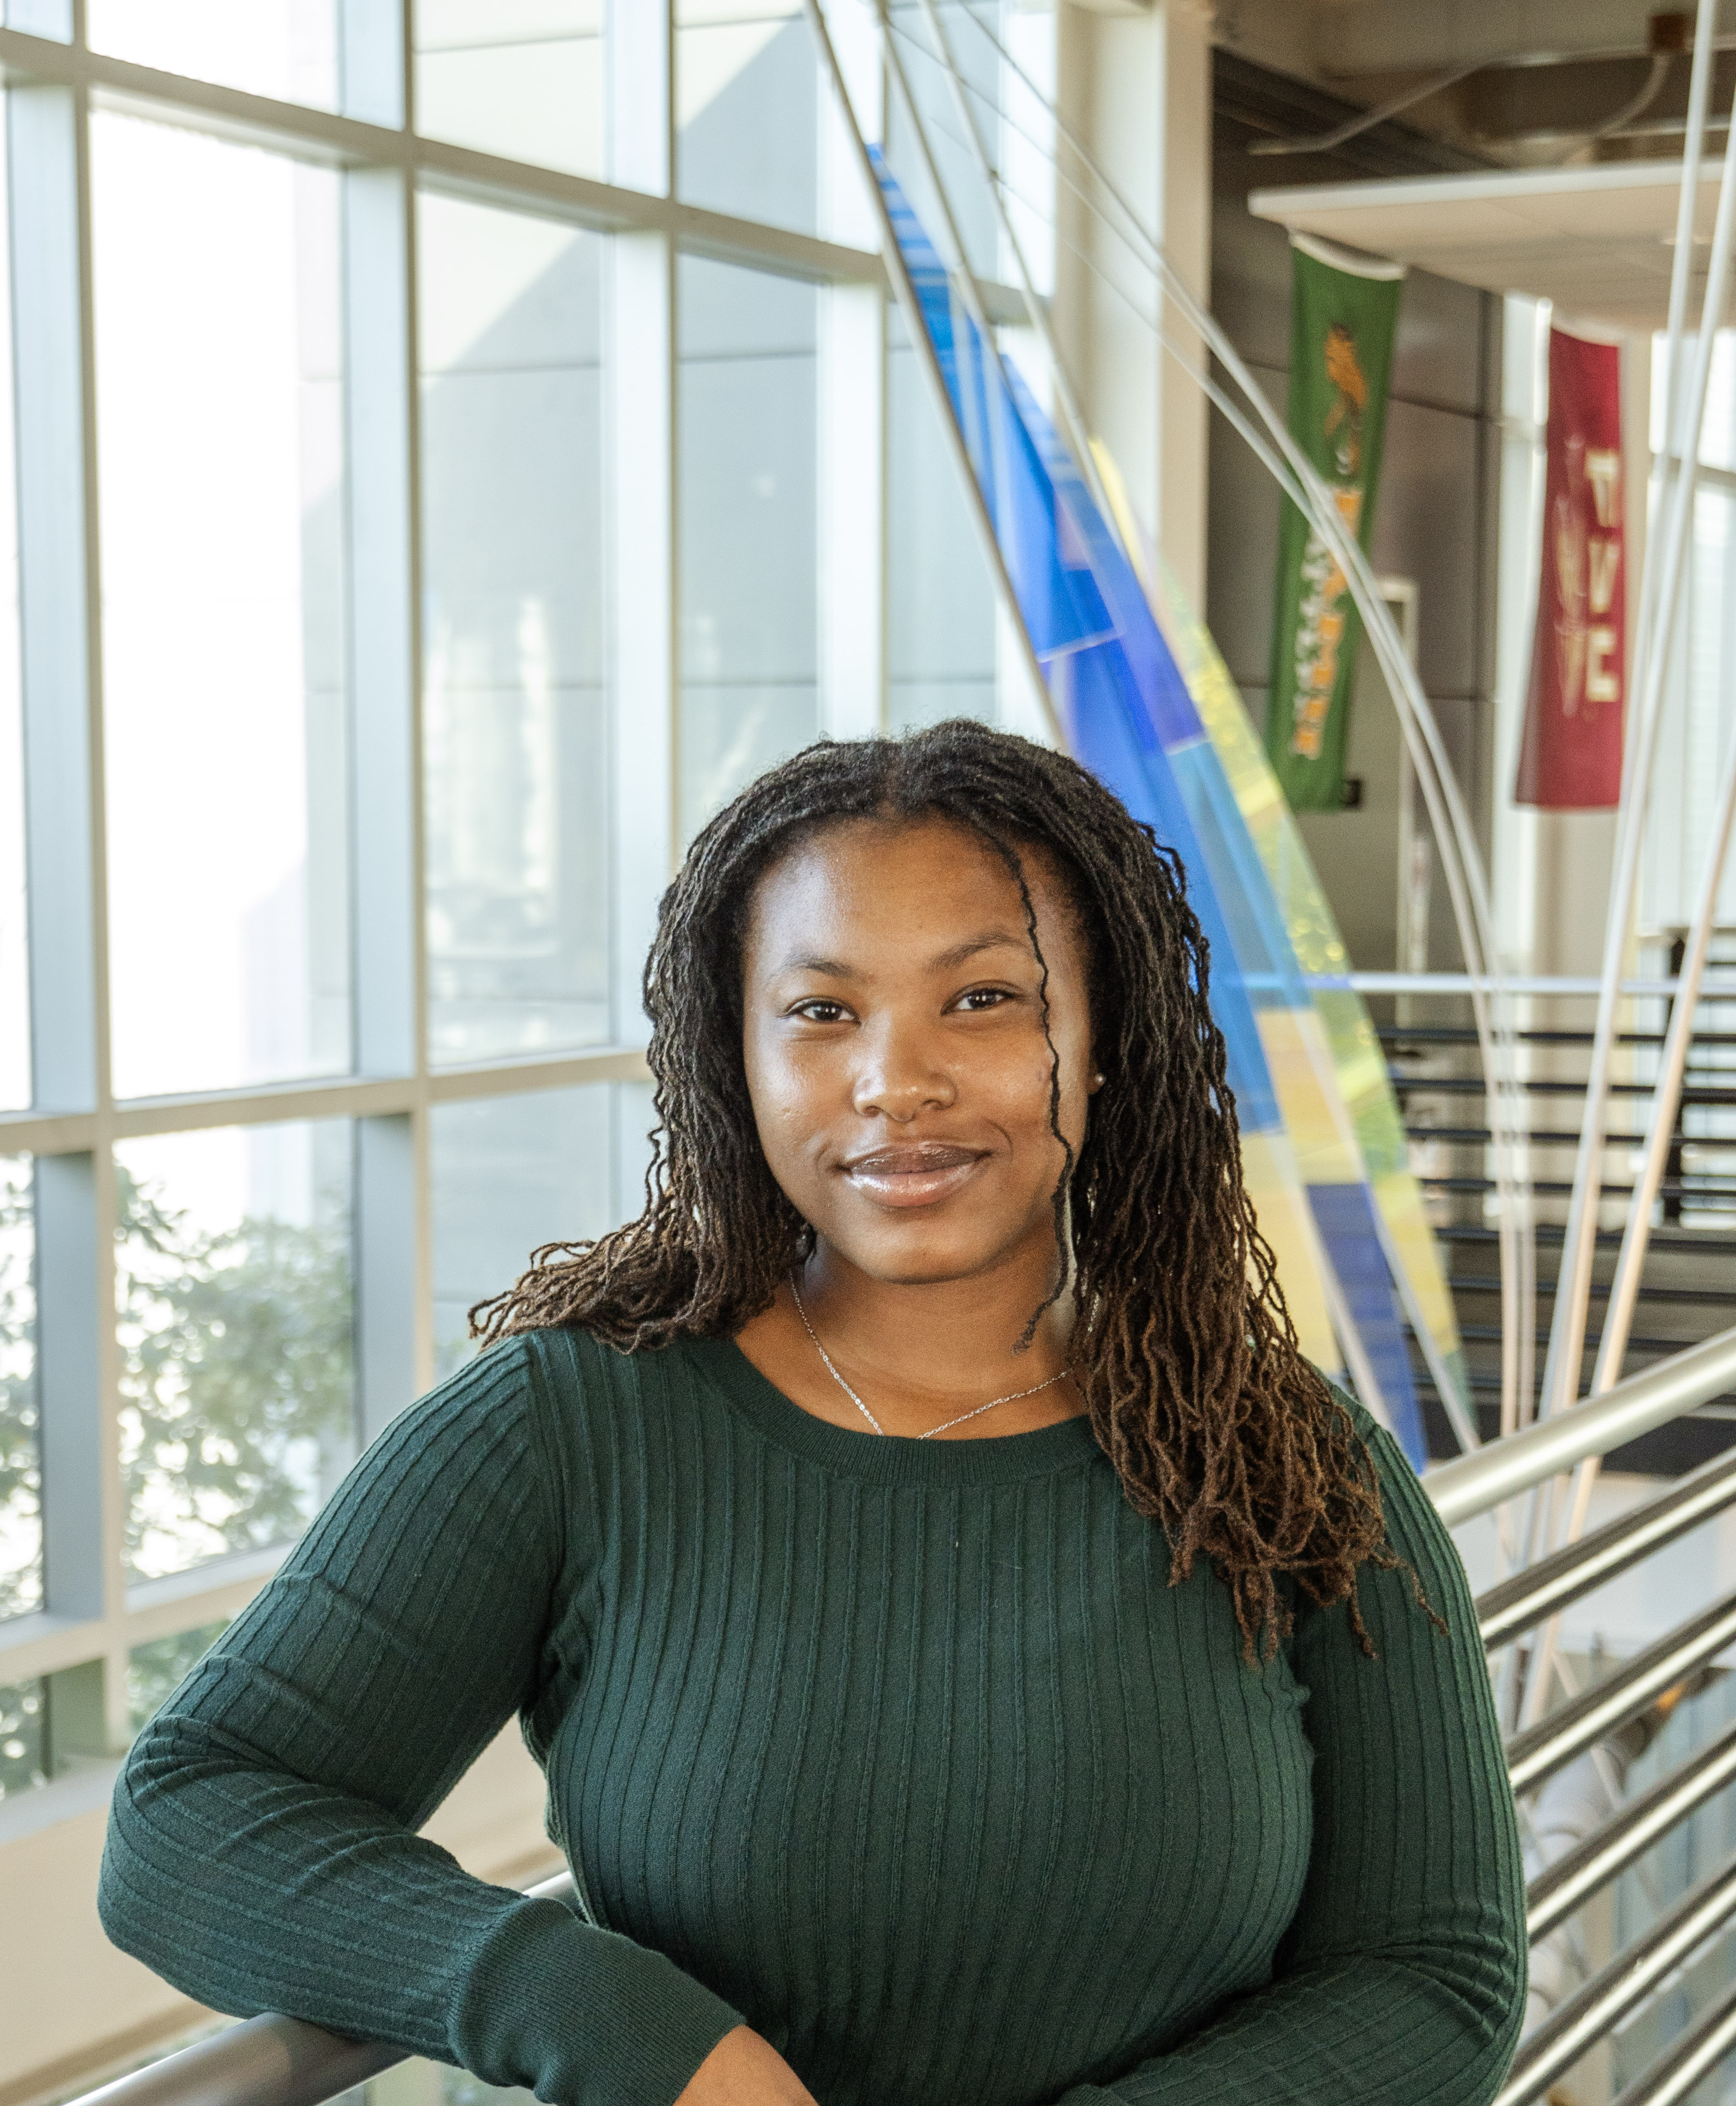
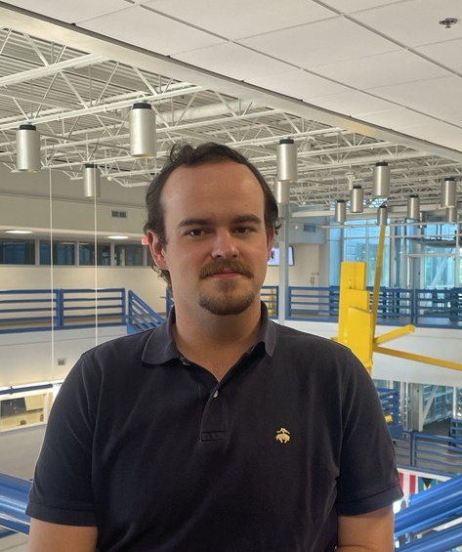


Team Introductions
Evan Cloutier
Project Manager
Nick Billmire
Digital Communication Engineer
Jada Davis
Software Engineer
Landon Hicks
PCB Design Engineer
Austin Roberts
Signal Processing Engineer
Dallas Toth Test Engineer

Slide 4
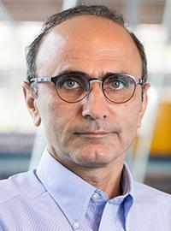
Sponsor and Advisors
Sponsor
L3Harris Technologies
Faculty Advisor
Babak Noroozi, Ph.D.
Professor

Slide 5
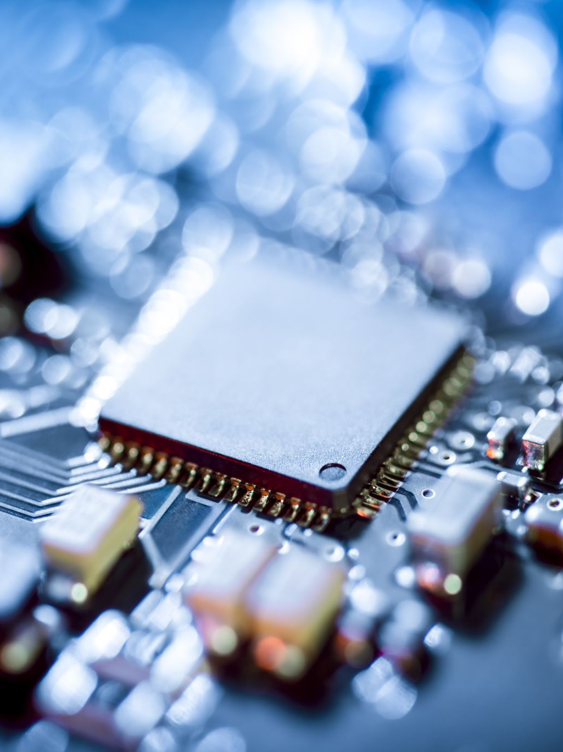
Original Project Description
Multi-Axial Angular Sensor:​
A form/fit/function replacement​
Design a circuit card assembly for a provided sensor​
Develop code needed to output the proper message format ​
Construct the card within given size limitations​
Regulate power to the sensor​
Output in RS-422 message format

Slide 6
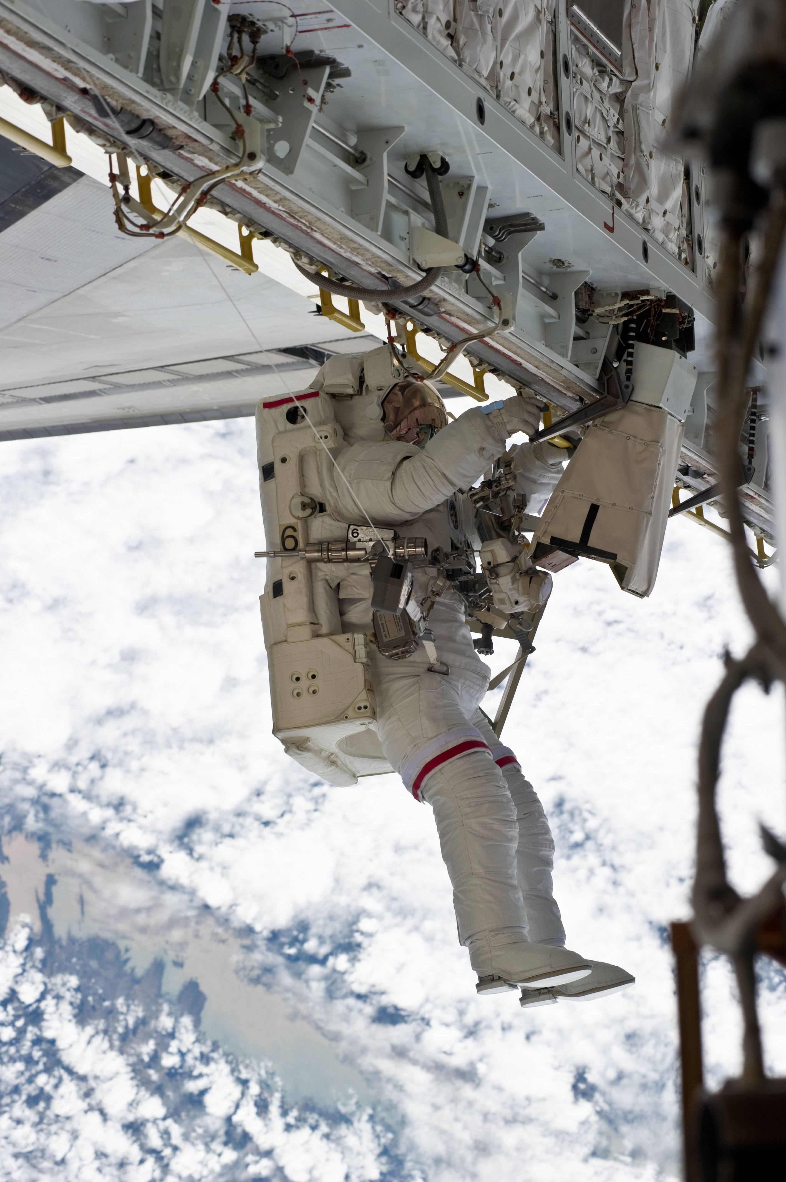
New Project Description
Sensor package capable of monitoring an astronaut’s vital signs and spacesuit environment during extravehicular activity (EVA)
Transmit sensor data to the main communications system via a serial interface such as RS-232
Detect abnormal readings and trigger appropriate alarms

Slide 7
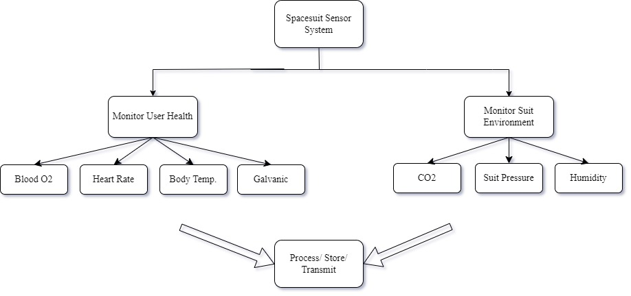
Functional Decomposition

Slide 8
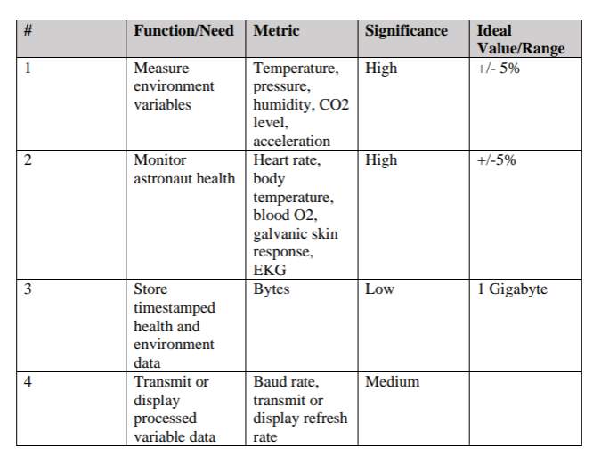

Targets
8 Gigabytes
8
9600 baud

Slide 9
Concept Generation and Selection

Slide 10
Concept Generation
Three high-fidelity concepts
Five medium-fidelity concepts
Close to 100 low-fidelity concepts

Slide 11
Concept Selection
Comparison Criteria Chart
 | Cost | Size | Weight | Power | Sample Rate | Accuracy | Ease of Application
Cost | 1 | 2 | 3 | 2 | 2 | 3 | 2
Size | 0.5 | 1 | 3 | 1 | 2 | 3 | 2
Weight | 0.5 | 0.5 | 1 | 0.5 | 0.5 | 0.5 | 0.5
Power | 1 | 1 | 3 | 1 | 2 | 2 | 1
Sample Rate | 0.5 | 1 | 3 | 0.5 | 1 | 1 | 1
Accuracy | 0.5 | 1 | 3 | 0.5 | 1 | 1 | 1
Ease of Application | 0.5 | 1 | 3 | 0.5 | 0.5 | 1 | 1
Sum | 4.5 | 7.5 | 19 | 6 | 9 | 11.5 | 8.5

Slide 12
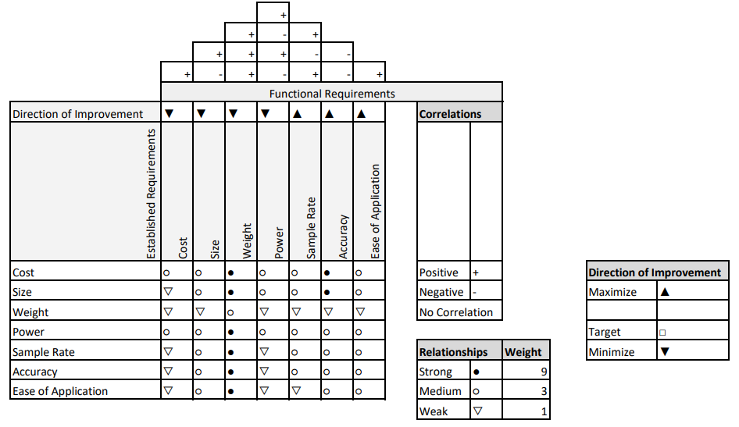
Concept Selection
House of Quality

Slide 13
Concept Selection
Concept 1
Concept 2
Concept 3
The spacesuit sensing unit comprises two main components: an internal wearable stocking worn by the astronaut underneath the base suit and an external device attachable to the suit or backpack. Both units wirelessly transmit data to an external control system, such as a laptop or desktop, for close monitoring of the astronaut's condition. The internal unit features sensors for tracking body temperature, blood oxygen levels, heart rate, sweat levels, and suit pressure. The external unit monitors environmental factors like angular acceleration, ambient temperature, humidity, gas presence, and radiation exposure around the astronaut.
Integrate a set of gloves and socks that communicate via RFID and contain heart rate, blood pressure, core body temperature, and Galvanic skin response (GSR) sensors that use RFID to report data back to a PCB containing an MCU and memory for processing and storage. The gloves can be environmental sensors and the socks can be internal sensors, or vice versa.
Create a wearable sock with a heart rate sensor, on-toe pulse oximeter, thermometer, and Galvanic skin response sensor. External to the sock, shall be a suite of environmental sensors, including a CO2 sensor, pressure sensor, humidity sensor, and an accelerometer. If multiple sensors are utilized for one particular measurement, the data collected will be taken as best average. The sensor data shall be sampled, timestamped, and logged in CSV format for transmission to another device via either a wired serial connection or RFID.

Slide 14
Concept Selection
Pugh Chart
 |  | Concept 1 | Concept 2 | Concept 3
Cost | 3 | 0 | -1 | 1
Size | 4 | -1 | -1 | 1
Weight | 5 | 1 | -1 | 1
Power | 2 | 0 | 0 | 0
Sample Rate | 4 | 0 | 0 | 0
Accuracy | 4 | 1 | 0 | 0
Ease of Application | 3 | 1 | -1 | 1
Score |  | 8 | -15 | 15
Continue? |  | No | No | Yes

Slide 15
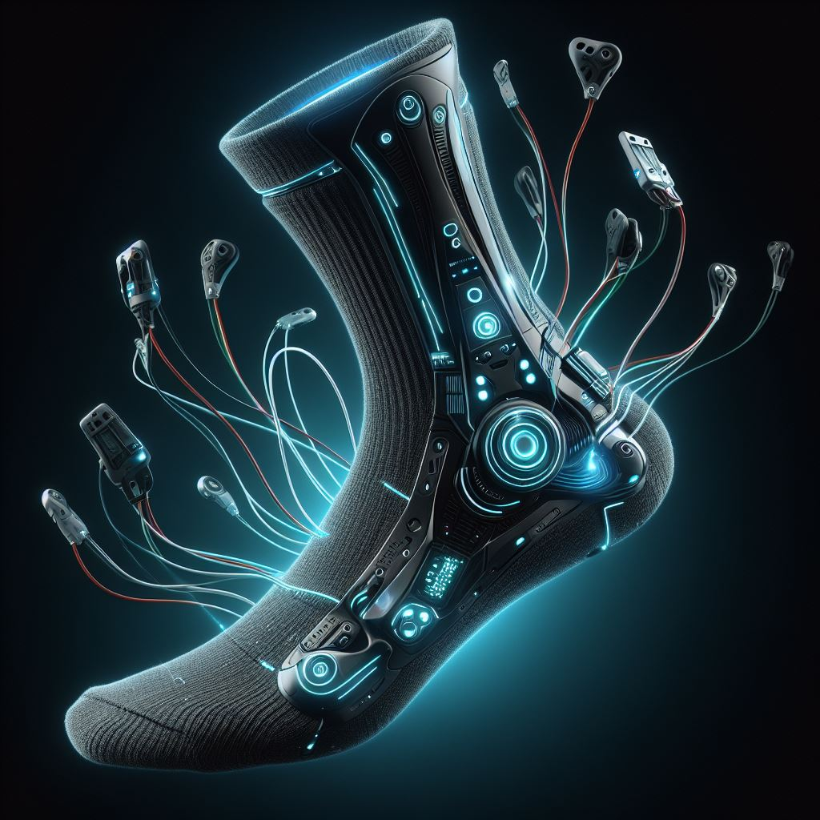
Selected Design
Sensing Sock and Environment Sensor Package
Wearable sock
Heart rate sensor
Pulse oximeter
Thermometer
Galvanic skin response sensor
External to the sock: spacesuit environment sensors
CO2
Pressure
Temperature/Humidity
Artistic rendering only; not an actual depiction.

Slide 16
Selected Design
Design Choice Justification
Performed exceptionally well against comparison criteria
Feasible to implement while containing certain manageably challenging aspects
Fitting biomedical sensors into a textile for the foot
Adequately logging and transmitting sensor data
Presents similar engineering challenges to the original project while resolving its deficiencies
Artistic rendering only; not an actual depiction.

Slide 17
Bill of Materials
SD Team 310 - Bill of Materials |  | SD Team 310 - Bill of Materials
 | Item Ref # | Description | Part Num. | Quantity | Unit | Unit Cost | Cost | Shipping | Total Cost
Sock | 1 | Sock | N/A | 1 | 6 pack | $15.00 | $15.00 | ? | $15.00
 | 2 | Heart Rate / Blood O2 Sensor | SEN-11574 | 2 | individual | $26.95 | $53.90 | ? | $53.90
 | 3 | Body Temperature | MAX30205 | 2 | individual | $59.55 | $119.10 | ? | $119.10
 | 4 | Skin Galvanic Sensor | 101020052 | 2 | individual | $10.90 | $21.80 | ? | $21.80
Environment-al Sensing Unit |  | CO2 Sensor | T6793-5K | 2 | individual | $38.90 | $77.80 | ? | $77.80
 | 5 | Pressure Sensor | BMP280 | 2 | individual | $9.95 | $19.90 | ? | $19.90
 | 6 | Humidity Sensor | SHT85 | 2 | individual | $32.18 | $64.36 | ? | $64.36
Processing | 7 | Microcrontroller | STM32F407G-DISC1 | 2 | individual | $21.39 | $42.78 | ? | $42.78
 | 8 | SD Card Storage | SDSDAF3-008G-I | 2 | individual | $11.37 | $22.74 | ? | $22.74
 | 9 | SD Card Holder | 410-123 | 2 | individual | $11.86 | $23.72 | ? | $23.72
 | 10 | RS232 to I2C I.C. | MAX3232CUE+T | 3 | individual | $6.27 | $18.81 | ? | $18.81
 | 11 | I2C to RS232 Converter | MIKROE-5056 | 3 | individual | $12.00 | $36.00 | ? | $36.00
Misc. | 12 | RS232 Male Connectors | 2301826-1 | 3 | individual | $2.20 | $6.60 | ? | $6.60
 | 13 | RS232 Female Connectors | 5-747905-5 | 3 | individual | $3.68 | $11.04 | ? | 11.04
 | 14 | RS232 to USB (for testing on PCs) | US232R-10-BULK | 1 | individual | $28.00 | $28.00 | ? | $28.00
 | 15 | RS232 F-F cable (1.5 ft) |  | 2 | individual | $8.28 | $16.56 | ? | $16.56
 | 16 | RS232 F-F cable (5 ft) |  | 2 | individual | $10.00 | $20.00 | ? | $20.00
 | 17 | RS232 M-F Adapter |  | 1 | 4-pack | $7.88 | $7.88 | ? | $7.88
 | 18 | RFID CHIP | EM4325V21TP8B+ | 3 | individual | $1.63 | $4.89 | ? | $4.89
 |  |  |  |  | Assuming total shipping cost of 15% |  |  | $91.63 | $702.51

Slide 18
Next Steps
Finalize the preliminary detailed design
Wait for all parts to come in the mail
Begin initial prototyping
Research signal processing techniques for all sensors
Determine additional materials needed ASAP

Slide 19
Backup Slides

Slide 21
Slide Headline
Try to keep text at 16 pt minimum.

Slide 22
Slide Headline
Try to keep text at 16 pt minimum.
Try to put as few words as possible on the slide if you’re using for a presentation.

Slide 23
Slide Headline
Try to keep text at 16 pt minimum.
Try to put as few words as possible on the slide if you’re using for a presentation.
Mix and match the backgrounds as shown in this template or just use one throughout.

Slide 24





Slide Headline
Try to keep text at 16 pt minimum.
Try to put as few words as possible on the slide if you’re using for a presentation.
Mix and match the backgrounds as shown in this template or just use one throughout.
You can put department/unit logos in slide master at Horizontal 0.89” Vertical 6.44” From top left corner

Slide 25
This is 10-point
This is 15–point Times
This is 20–point
This is 25–point
This is 30–point
This is 35–point
This is 40–point
This is 50–point
This is 60–point
This is 72–point
Notes:
Use at least 20-point font in Room A105, B134, and B136
Use at least 25-point font in Room B135

Slide 26
College of Engineering Color Palette
1 2 3 4
Pantone: PMS 195 C
RGB: 120, 47, 64
Hex: #782F40
CMYK:19, 90, 50, 55
1 2 3 4
Pantone: Black C
RGB: 0, 0, 0
Hex: #000000
CMYK:0, 0, 0, 100
Garnet
Black
1 2 3 4
RGB: 238, 118, 36
Hex: #EE7624
CMYK:2, 66, 99, 0
1 2 3 4
Pantone: PMS 000C
RGB: 255, 255, 255
Hex: #FFFFFF
CMYK: 0, 0, 0, 0
Fang
Orange
White
Notes:
Avoid 75% Black in B135

Slide 27
Accent Color Palette
1 2 3 4
RGB: 0, 59, 111
Hex: #003B6F
CMYK:
1 2 3 4
RGB: 0, 59, 111
Hex: #003B6F
CMYK:
1 2 3 4
RGB: 251, 236, 93
Hex: #FBEC5D
CMYK:
1 2 3 4
RGB: 219, 215, 210
Hex: #DBD7D2
CMYK:
1 2 3 4
RGB: 251, 236, 93
Hex: #FBEC5D
CMYK:
1 2 3 4
RGB: 219, 215, 210
Hex: #DBD7D2
CMYK:
Tardis Blue
Tardis Blue
Corn
Timberwolf
Corn
Timberwolf
1 2 3 4
RGB: 206, 0, 88
Hex: #CE0058
CMYK: 0, 100, 43, 12
1 2 3 4
RGB: 206, 0, 88
Hex: #CE0058
CMYK: 0, 100, 43, 12
1 2 3 4
RGB: 104, 40, 96
Hex: #682860
CMYK:
1 2 3 4
RGB: 220, 220, 220
Hex: #DCDCDC
CMYK:
Rubine Red
Rubine Red
Imperial
Gainsboro
1 2 3 4
RGB: 72, 146, 155
Hex: #48929b
CMYK:
1 2 3 4
RGB: 64, 224, 208
Hex: #40E0D0
CMYK:
1 2 3 4
RGB: 255, 139, 0
Hex: #FF8B00
CMYK:
Asagi-iro
Turquoise
American Orange
Notes:
Remove American orange add hyperlink grey
Make corn the last for b135
All work in 134 imperial move later
Tardis doesn’t work in b136

Slide 28
F7AB19
D67F15
EE7624
D64615
F73119
Analogous
https://color.adobe.com/create/color-wheel
6E3610
F0A16C
EE7624
6E4931
BASB1C
Monochromatic
A14508
4BED3B
EE7624
250CED
2010A1
Triad
A1470C
FF8C40
EE7624
0098A1
24E2ED
Complementary
28A164
2FED8D
EE7624
0848A1
1871ED
Split Complementary
EDAC2F
3BED93
EE7624
0C6AED
ED2F18
Double Split Complementary
ED660C
C7ED3B
EE7624
0CE1ED
A418ED
Square
BA7E09
87724A
EE7624
60EFCF
09BA61
Compound
AD551A
6E3610
EE7624
FA7625
D46820
Shades
Notes:
These are the variants that work well with Fang Orange. The bolded items show well on the projectors.

Slide 29
85412D
8F3831
782f40
8F3176
792D85
Analogous
https://color.adobe.com/create/color-wheel
C44D69
8E626D
782F40
C48796
451B25
Monochromatic
C43959
78743B
782F40
236178
43A2C4
Triad
C43959
C46078
782F40
25C43D
2F783A
Complementary
93C460
577835
782F40
39C49D
297861
Split Complementary
784435
5A783B
782F40
237860
6E2978
Double Split Complementary
782337
78683b
782F40
237830
293978
Square
AB4D32
DEBAAF
782F40
5D8555
70AB32
Compound
38161E
C44D69
782F40
853447
5E2532
Shades

Slide 30
A105
A105
B135 Stage Left
B135 Stage Right
B136
B134, A105
B135

